Slide 1


AUTOMATED CNC POTTING MACHINE FOR NURSERIES
By
UJWAL WAGHRAY(1171310091)
SHIBIN VARGHESE PHILIP(1171310066)
Under the guidance of
(Mr.P.JEKAN)
Department of Electronics and Instrumentation Engineering
Faculty of Engineering and Technology
SRM University

Slide 2
ABSTRACT
Automated CNC Potting Machineis an open source and scalable automated precision farming machine and software. Similar to today’s 3d printers or CNC milling machines, CNC farm hardware employs linear guides in the y, z directions and moves the trays in the x direction on a conveyor belt that allow for tooling such as plows, seed injectors, watering nozzles, and sensors, to be precisely positioned and used on the plants and soil. The entire system is numerically controlled and thus fully automated from ploughing to harvest. The hardware designed uses open source protocol a person can design their farm to their desired specification like number of pots to be manufactured at a time, speed of manufacturing and upload numerical control code to the hardware.
The on board sensors are used in detecting the soil conditions, position of trays and pots and execute the task of ploughing, watering, soil testing and seeding based on the requirements.
Show quoted text

Slide 3
LITERATURE SURVEY
Text-28 point times new roman
Explain abt the summery of base paper(min 2)

Slide 4
OBJECTIVES – 32 point
To design an automated robotic control system for plant crop manufacturing.
To reduce the resource consumption by decreasing water and electricity usage.
To make an open source system which is flexible to crops and pots.
To introduce non-human involving methodology and techniques in agriculture.
To be able to control the manufacturing remotely without any human help

Slide 5
INTRODUCTION
Automated CNC farming is the new methodology through which cropping and planting has been made automatic with the help of a well programmed bot. The world’s population is growing and with that we must grow more food. Due to industrial and petrochemical evolutions, the agricultural industry has kept up it’s food production, but only by compromising the soil, environment and our health.

Slide 6
INTRODUCTION
Conventional agriculture methods are undependable and paradigm shift is needed. Automated CNC potting machine solves this problem by nurturig them in nurseries, thus exponentially increasing food production. Our aim is to automate the production of food crops by designing and building and automated robotic machine for food production.

Slide 7
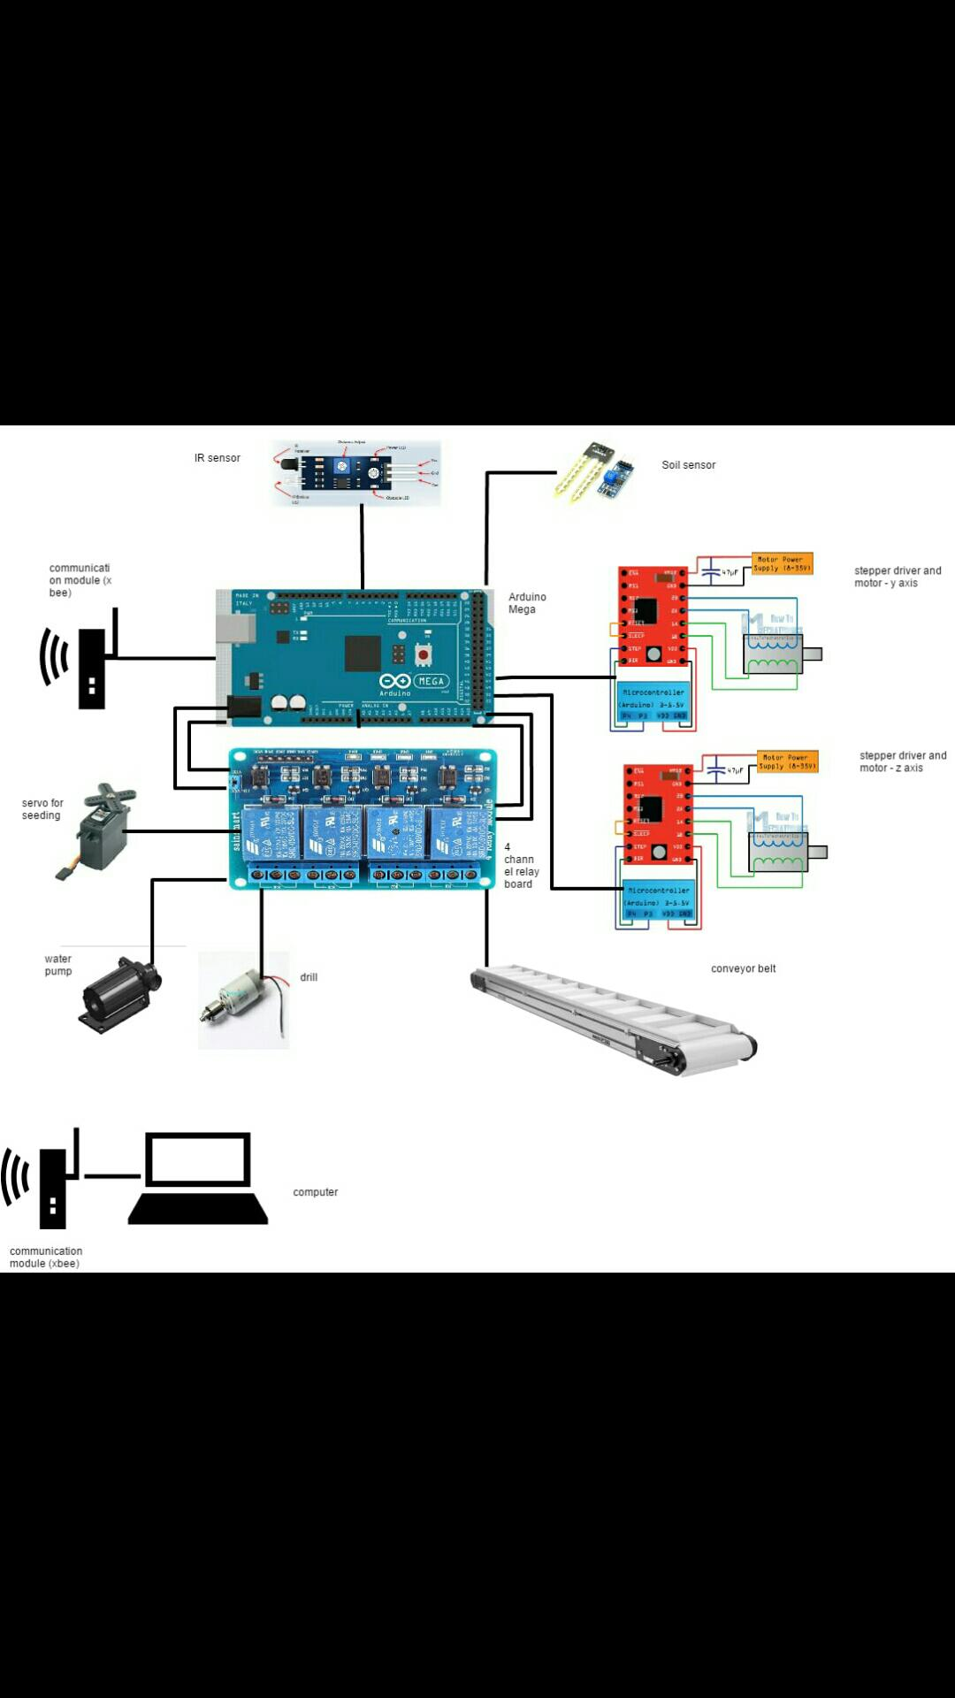
BLOCK DIAGRAM

Slide 8
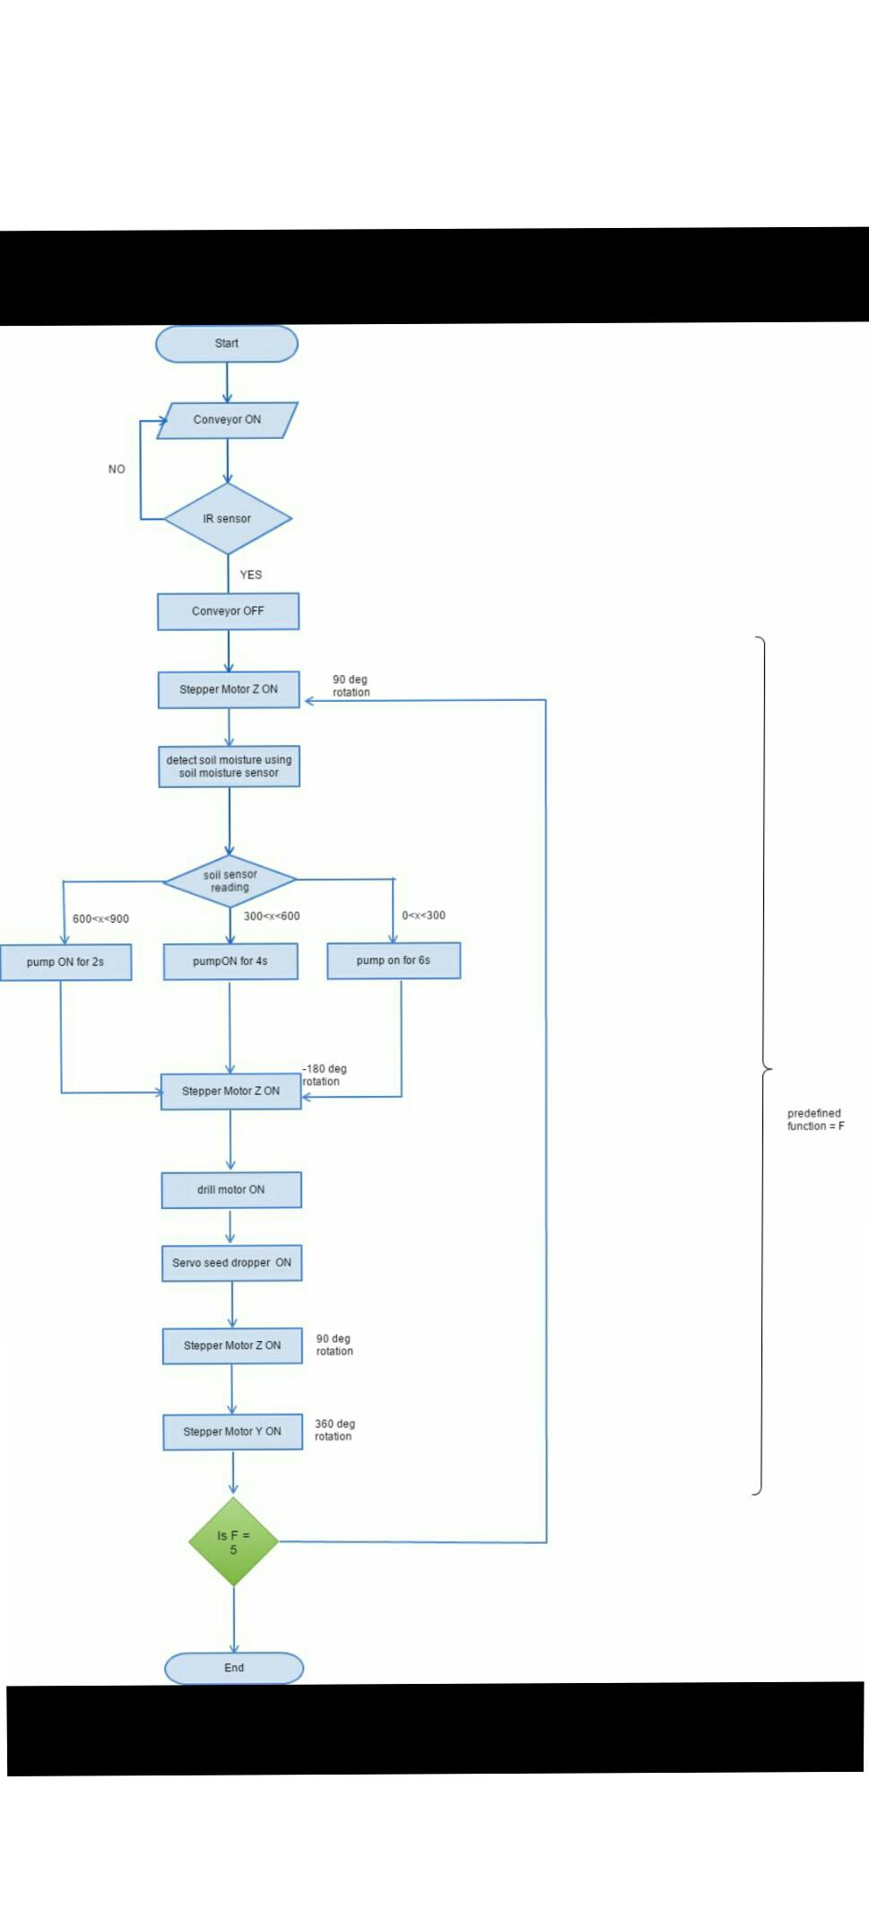
BLOCK DIAGRAM

Slide 9
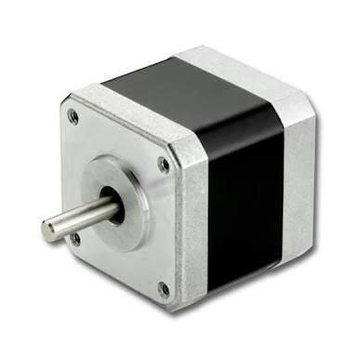
WORKING
A stepper motor or step motor or stepping motor is a brushless DC electric motor that divides a full rotation into a number of equal steps. The motor's position can then be commanded to move and hold at one of these without (an open-loop controller), as long as the motor is carefully sized to the application in respect to torque and speed.

Slide 10
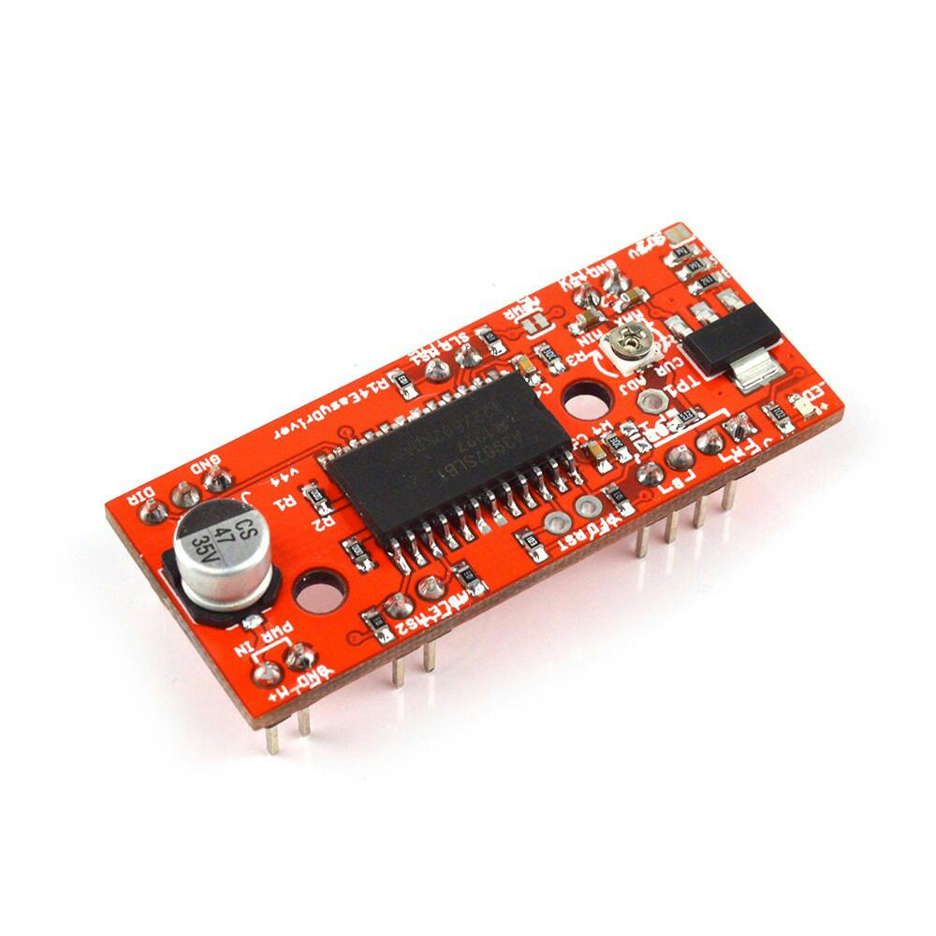
WORKING
The A4988 is a microstepping driver for controlling bipolar stepper motors which has built-in translator for easy operation. This means that we can control the stepper motor with just 2 pins from our controller, or one for controlling the rotation direction and the other for controlling the steps.

Slide 11
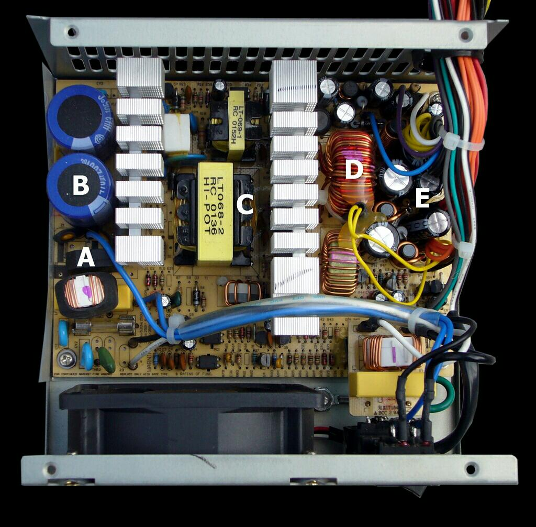
WORKING
A switched-mode power supply (SMPS) is an electronic circuit that converts power using switching devices that are turned on and off at high frequencies, and storage components such as inductors or capacitors to supply power when the switching device is in its non-conduction state.

Slide 12
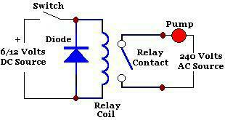
WORKING
Relay Switch Circuit
Relays are electromechanical devices that use an electromagnet to operate a pair of movable contacts from an open position to a closed position.

Slide 13
DELIVERABLES
The deliverables are as follows-
CAD designing of gantry systems and fabrication.
Conveyer belt design as well as fabrication.
Electronic control of the system
Feedback system design and fabrication.

Slide 14
CONCLUSION
Text-28 point times new roman

Slide 15
TIME LINE
WORK TO BE DONE
WORK DONE

Slide 16
REFERENCES
"FarmBot Genesis seeds, waters, and fertilizes your garden with life-giving precision“ Reference 1
"FarmBot is the world's first open source CNC farming machine“Atmel bits amd pieces.
Liptak, Bela G. (2005). Instrument Engineers' Handbook: Process Control and Optimization

Slide 17
THANK YOU

